Slide 1
JS and the DOM
Mr Mack 2022

Slide 2
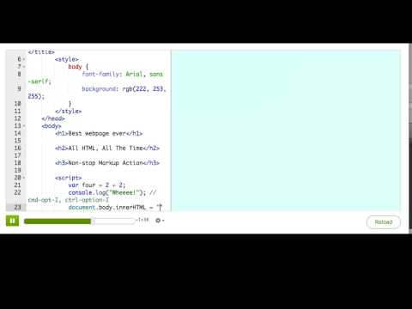
Putting JS in a webpage

Slide 3

Practice: A scripted script tag
This webpage has HTML tags and CSS, but no JS in it yet. Add a <script> tag to the bottom, so that you can manipulate the webpage with JS.
Add a script tag

Slide 4

Practice: A scripted script tag
Inside the <script> tag, use the line of code that we showed you to replace the contents of the webpage with a custom message instead - it can say whatever you want, as long as it's a few letters long. We'll explain more about how that line of code works in the next talk-through.
Replace the webpage with JS

Slide 5
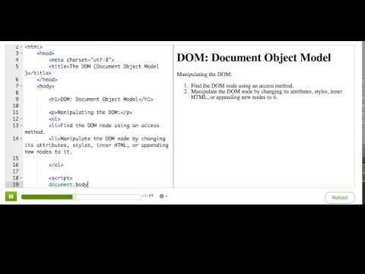
The DOM (Document Object Model)

Slide 6
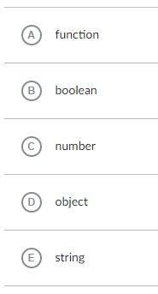
What sort of data type does the document variable store?
Notes:
🍐 This is a Pear Deck Multiple Choice Slide. Your current options are: A: A, B: B, C: C, D: D, E: E,
🍐 To edit the type of question or choices, go back to the "Ask Students a Question" in the Pear Deck sidebar.

Slide 7
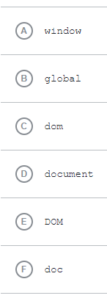
When you're writing JS on a webpage, what is the name of the global variable that represents the DOM?
Notes:
🍐 This is a Pear Deck Multiple Choice Slide. Your current options are: A: A, B: B, C: C, D: D, E: E, F: F,
🍐 To edit the type of question or choices, go back to the "Ask Students a Question" in the Pear Deck sidebar.

Slide 8
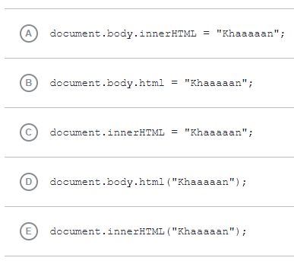
Which of these lines of code would replace the content of a webpage with "Khaaaaan"?
Notes:
🍐 This is a Pear Deck Multiple Choice Slide. Your current options are: A: A, B: B, C: C, D: D, E: E,
🍐 To edit the type of question or choices, go back to the "Ask Students a Question" in the Pear Deck sidebar.

Slide 9
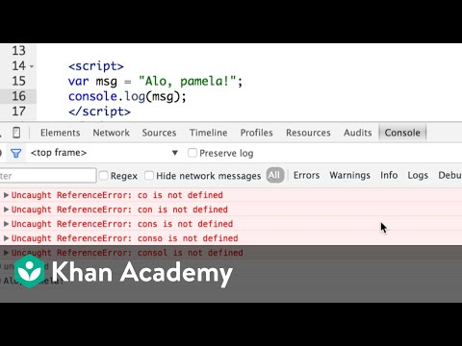
Debugging webpages with the browser console

